Slide 1
Introduction to the HPC Cluster
Rollins School of Public Health
Spring 2019

Slide 2
What is the (an) HPC Cluster?

Slide 3
The HPC Cluster Layout
Compute nodes
Submit hosts
Storage service
Scheduler
License Manager

Slide 5
Submit hosts and Compute Nodes
Sumit hosts:
Your “login host”. You ssh-in to this machine: ssh <userid>@<submit_host>
You most likely will need VPN access to reach these (some campus wired connections are accepted)
Firewall timeout: 15 minutes
You copy data onto these systems, which have your home and project directories available (which are mounted everywhere)
Limited application availability - don’t run jobs on these systems
Named “hpc3”, “hpc4”, “hpc5”, etc.
Compute nodes:
These are where the jobs are run
Applications readily available here
No direct login access
Many cores, large amounts of RAM
Physical servers (not VMs)
Named after fruit (“apple”, “banana”, “cherry”) or research group (“gene1”, “gene2”, etc.) or randomly (“dynareg1”)
There are 32 compute nodes
664 cores -> 1328 threads total
Running RHEL 7

Slide 6
Preliminaries: Changing your $SHELL
A legacy “feature” of central IT at Emory: everyone’s Unix shell is set to ‘ksh’ in LDAP.
Literally no one uses ksh anymore. Default shell on Linux, Mac OS X and even Solaris is bash now, and has been for years.
In process of getting it changed, but until then, all new Emory users have to change it themselves: https://mynetid.emory.edu/IDMProv/portal/cn/DefaultContainerPage/WelcometoMyNetID
Call 7-7777 (Central IT help line) for assistance.

Slide 7
Logging in to the Cluster
We use ssh (Secure Shell) to log into the submit hosts
The easiest operating systems: Linux and Mac OS X clients. Use the provided terminal program, and ssh is already included.
Windows: more complicated. You’ll need an ssh client. There are at least three options:
Install Putty. Go to putty.org, download 64-bit .msi file and install. It works on older Windows systems
On Windows 10, use Windows Subsystem for Linux. Download Ubuntu from Windows store
Install Linux via a virtual machine: e.g., VirtualBox or VMWare
Excellent how-to video at www.lynda.com: Learning Linux Command Line

Slide 8
Using SSH
Use command ssh <username>@<submit_host>.sph.emory.edu, e.g., “ssh fred@hpc6.sph.emory.edu”
Accept new key the first time you login
Best practice: password-less key exchange and ssh-agent
ssh-copy-id works well from any Linux/Mac OS X terminal.
.ssh/config can be used to save aliases to further reduce typing.

Slide 9
Connecting to the Cluster: VPN, firewalls, screen
If you connect to the cluster from an off-site location, including Emory Unplugged (Emory’s wireless network), you’ll need access to the Emory VPN. This is granted by individual request by central IT (LITS): https://it.emory.edu/security/vpn.html
Once logged in, both the VPN and the network firewall settings can “time out”.
As a work-around, use the Unix command screen.
After logging in, simply type ‘screen’. It will return a prompt to you, as if nothing happened. Type “<ctrl>-a d”, to exit a screen.
If your connection gets dropped (while in a screen), you can “reattach” to the session via screen -r. (Type ‘<ctrl>-a ?’ in screen, for command list.)

Slide 10
Unix: a few helpful commands
du : shows disk usage. Ex: du -hs /home/<netid> shows how large your home directory is (in gigabytes). (This command may take a few minutes to complete.)
ls : list files in current working directory
pwd : print working directory
more : read contents of a text file, with paging
chown : change user or group ownership of a file
vim : a lightweight text file editor (worth learning)
man : read manual pages. Ex. man chown
scp : secure copy, part of ssh
There is an entire free course at www.lynda.com: Learning Linux Command Line

Slide 11
Using the Cluster: Grid Engine q-commands
Work on the cluster is submitted in the form of “jobs”, or programming tasks, that are sent to the compute nodes from the submit nodes. The q-commands are Grid Engine commands that perform various job functions:
Submit jobs qsub, qlogin
Check job status qstat
Delete jobs qdel
Cluster/queue state qhost, qstat

Slide 12
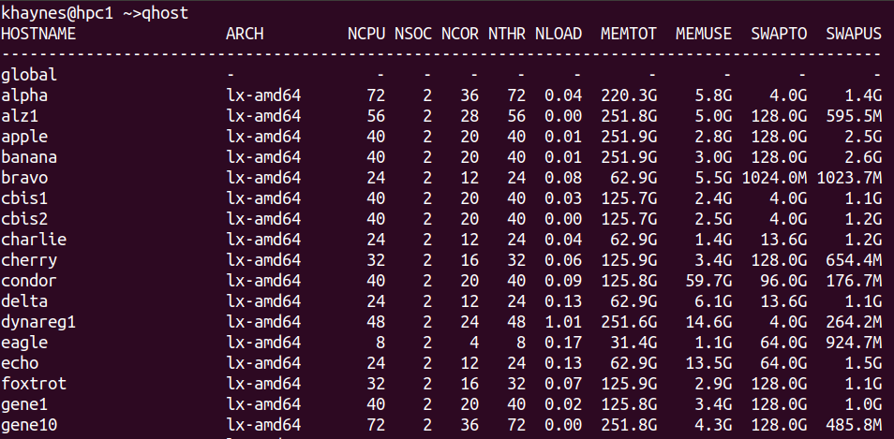
Cluster status: qhost - show available hosts

Slide 13
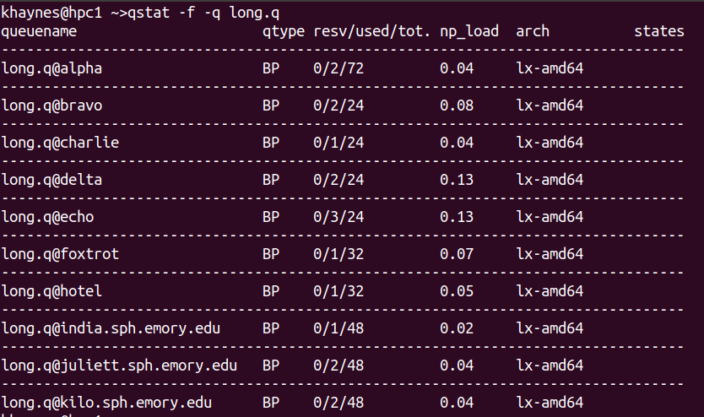
Cluster status: qstat -f

Slide 14
Submitting jobs: qsub
Batch job submission is done via qsub
qsub <program_name> submits a job running <program_name> with default attributes, after which the job will appear in the output of qstat
Many attributes can be specified, such as run queue, input, output, job name, memory usage, etc.
Ex. qsub -cwd -i /data/example.in -o /results/example.out -N testrun1 -q long.q -l mem_free=2GB R_wrapper_script.sh
That’s a lot of typing! Most people put those attributes in a job submission script.

Slide 15
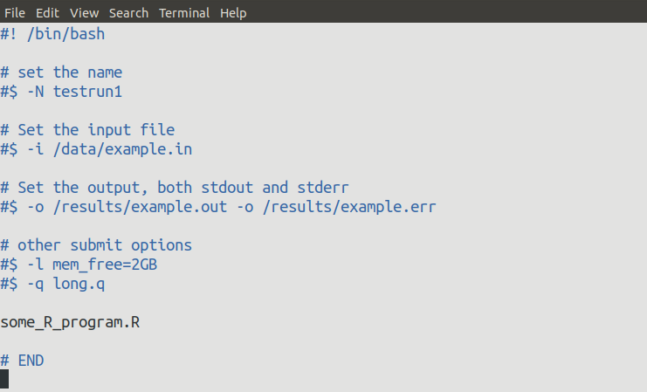
A sample job submission script.

Slide 16
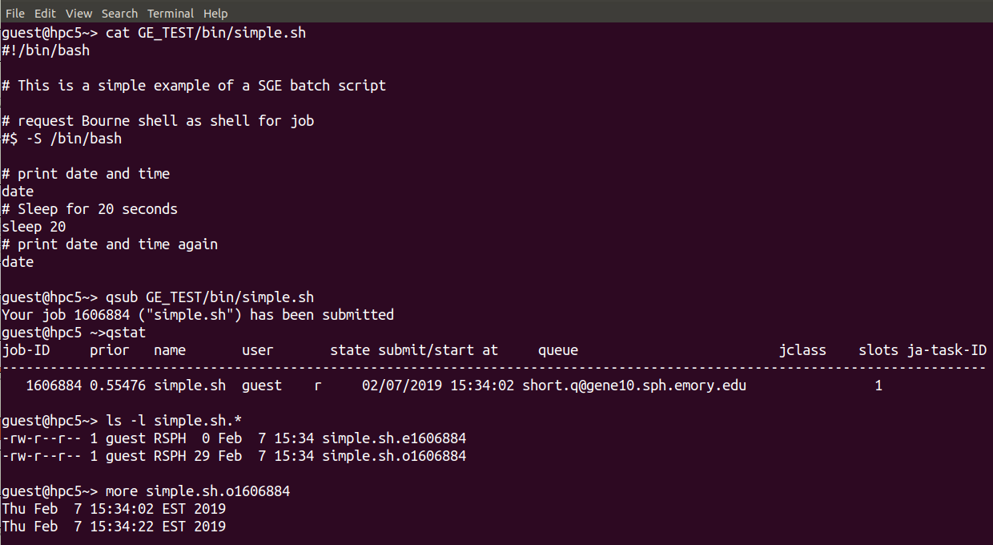
A qsub workflow example.

Slide 17
Checking on Jobs: qstat and qacct
qstat (without arguments) shows the status all of your currently queued jobs
Jobs usually have status of r (“running”), qw (“queue wait” or pending), or Eqw (in and “error” state)
Use qacct -j <job_id> to get detailed information about any job.

Slide 18
Killing jobs: qdel
Use qdel <job_id> to kill a submitted job

Slide 19
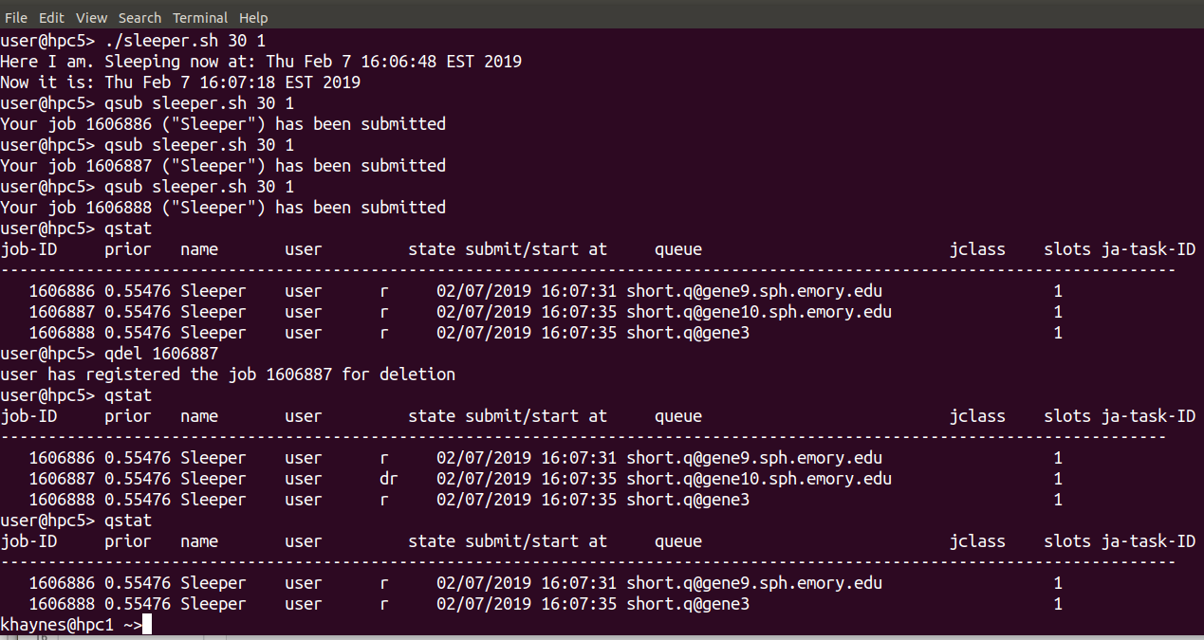
A qdel workflow example.

Slide 20
Cluster queues
qlogin.q - interactive sessions; dedicated 64 cores; timeout after 24 hours
long.q - general use; no time limit; 14 jobs/user max.
short.q - general use subordinate queue; 72 hour limit; 240 cores; limited to 40 jobs/user
Restricted queues: fruit.q, gene.q, sunlab.q, cbis.q, alz.q, mh.q
Restricted queues have priority on owned systems, and have no per user job limit or run-time limit
All queues have corresponding parallel queue (long, short, gene, etc. )
Ex. qsub -pe long 4 <program_name> requests a parallel environment with four processors

Slide 21
Available Software
C/C++, Fortran compilers
Python*
R**
MATLAB
SAS
Openmpi
Others, including user-installed

Slide 22
Storage on Cluster
Each account is granted a home directory in /home/<NetID>, which is mounted across all nodes of the cluster (i.e., software installed there is available everywhere). (“Isilon” storage, maintained by LITS)
Initial quota is set to 16 GB. Quota can be increased once, no questions asked. Users are responsible for deleting/off-loading and compressing files.
For large data installations, request a project directory. There is a cost associated with project directories, depending on type. (The latest pricing change has not been announced at time of slide creation.)

Slide 23
More info
For technical help with the cluster (including new account requests), send email to “help@sph.emory.edu”
Excellent how-to videos are available to Emory community (free!) via www.lynda.com. Click on sign in, then enter “emory.edu” for the domain, and you will be redirected to Emory for sign in. Search for “Learning Linux Command Line” for video instructions on how to install Windows Subsystem for Linux or Linux in a virtual machine (plus, basic Linux usage).
The old HPC Cluster documentation is still here: https://intranet.sph.emory.edu/services/it/environment/cluster/index.html
(It is in need of updating!)

